Slide 1

IOT-BASED SMART ENERGY METER WITH CLOUD MONITORING
End Sem. Presentation ON
UNDER THE SUPERVISION OF :
Simran ma’am
PRESENTED BY :
Anuj Kumar (25bec10118-312 “A”)
Lakshit
BACHELOR OF ELECTRONICS AND COMMUNICATION(AU-3)
INSTITUTE – UIE
CHANDIGARH UNIVERSITY
March 11th, 2026

Slide 2
Outlines
S. No. | Content
1 | Motivation
2 | Introduction
3 | Problem Statement
4 | Objectives
5 | Methodology
6 | Project Outcomes
7 | Conclusions & Future Scope
8 | Reference

Slide 3
Motivation
Increasing Electricity Consumption – The demand for electricity is increasing rapidly, so efficient monitoring of energy usage is required.
Lack of Real-Time Monitoring – Traditional energy meters do not provide real-time information about electricity consumption.
Energy Waste Reduction – Monitoring energy usage helps users identify unnecessary power consumption and reduce wastage.
Remote Access and Control – IoT technology allows users to monitor electricity usage from anywhere using mobile or web applications.
Improved Energy Management – Real-time data helps consumers manage and plan their energy usage more effectively.
Cost Saving – By monitoring energy consumption, users can reduce electricity bills.
Smart Grid Integration – IoT-based meters support future smart grid systems for better energy distribution.
Support for Smart Homes and Smart Cities – This system is useful for modern smart infrastructure and automation.
Notes:
Gary
Watch what people do with your site/application, not what they say about a design.

Slide 4
Introduction
Electricity consumption is increasing rapidly in homes, industries, and commercial areas, creating a need for efficient energy monitoring systems.
Traditional electricity meters only record total energy usage and do not provide real-time information to users.
IoT-Based Smart Energy Meter is designed to measure electrical parameters such as voltage, current, power, and energy consumption.
The system uses IoT technology to send collected data to a cloud platform through Wi-Fi for storage and analysis.
Users can monitor their electricity usage remotely using a mobile phone or Web dashboard.
This project helps in better energy management, reduces power wastage, and supports smart home and smart city applications.
Notes:
Gary
Watch what people do with your site/application, not what they say about a design.

Slide 5
Problem Statement
Manual Meter Reading – Traditional electricity meters require manual reading, which is time-consuming and may lead to human errors.
No Real-Time Monitoring – Existing meters do not provide real-time information about electricity consumption to users.
Energy Wastage – Without proper monitoring, users cannot identify unnecessary power usage, leading to energy wastage.
Delayed Billing Information – Consumers usually know their electricity usage only when the monthly bill arrives.
Limited Accessibility – Traditional systems do not allow users to monitor electricity consumption remotely.
Need for Smart Energy Management – There is a need for a smart system that can monitor energy usage in real time and store the data on a cloud platform for easy access.
Notes:
Gary
Watch what people do with your site/application, not what they say about a design.

Slide 6
Objective
To measure electrical parameters such as voltage, current, power, and energy consumption accurately
To develop a smart energy monitoring system using IoT technology.
To send energy consumption data to the cloud for storage and analysis.
To enable remote monitoring of electricity usage through a mobile or web dashboard.
To reduce energy wastage by providing real-time information to users.
To improve energy management and help users control their electricity consumption and cost.
Notes:
Gary
Watch what people do with your site/application, not what they say about a design.

Slide 7
Methodology
System Design – Design the smart energy meter system using sensors, a microcontroller, and a Wi-Fi communication module.
Data Measurement – Sensors measure electrical parameters such as voltage, current, power, and energy consumption.
Data Processing – The microcontroller processes the collected data from the sensors.
Data Transmission – The processed data is sent to a cloud platform using IoT and Wi-Fi technology.
Cloud Storage and Monitoring – The cloud platform stores the data and displays it on a dashboard for users.
User Access – Users can monitor electricity consumption remotely through a mobile phone or web application.
Notes:
Gary
Watch what people do with your site/application, not what they say about a design.

Slide 8
Project Outcomes
Remote Access to Data – Users can monitor their energy usage from anywhere using a mobile phone or web dashboard.
Accurate Measurement – The project provides accurate readings of electrical parameters such as voltage, current, power, and energy.
Cloud Data Storage – Energy consumption data is stored on a cloud platform for easy access and analysis.
Real-Time Energy Monitoring – The system successfully measures and displays electricity consumption in real time.
Energy Efficiency Improvement – Helps users identify unnecessary power usage and reduce energy wastage.
Smart Energy Management – Provides a modern solution for efficient electricity monitoring in homes and industries.

Slide 9
Conclusion
The IoT-Based Smart Energy Meter with Cloud Monitoring provides an efficient way to monitor electricity consumption in real time.
The system measures important electrical parameters such as voltage, current, power, and energy usage accurately.
By using IoT technology, the collected data can be sent to the cloud and accessed remotely by users.
This helps consumers understand their electricity usage and reduce unnecessary power consumption.
Overall, the project improves energy management and supports the development of smart homes and smart energy systems.

Slide 10
Future Scope
The system can be integrated with mobile applications for better user interface and notifications.
It can be connected with smart home automation systems to automatically control electrical appliances.
Advanced data analytics and AI can be used to predict future energy consumption.
The system can include alert features to notify users about high electricity usage or overload conditions.
It can be implemented on a large scale in smart grids and smart cities for efficient energy distribution.

Slide 11
References
Research papers and articles on IoT-based smart energy meter systems from IEEE Xplore Digital Library.
Research papers and articles on IoT-based smart energy meter systems from IEEE Xplore Digital Library.
Online resources and tutorials related to IoT and smart energy monitoring systems.
Notes:
Gary
Watch what people do with your site/application, not what they say about a design.

Slide 12
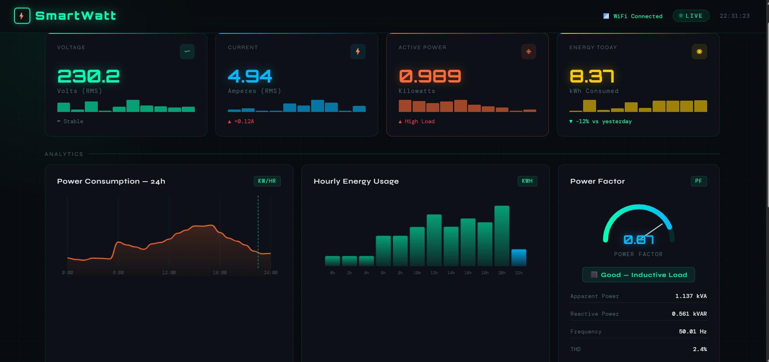
CLOUDE MONITORING DASHBOARD

Slide 13
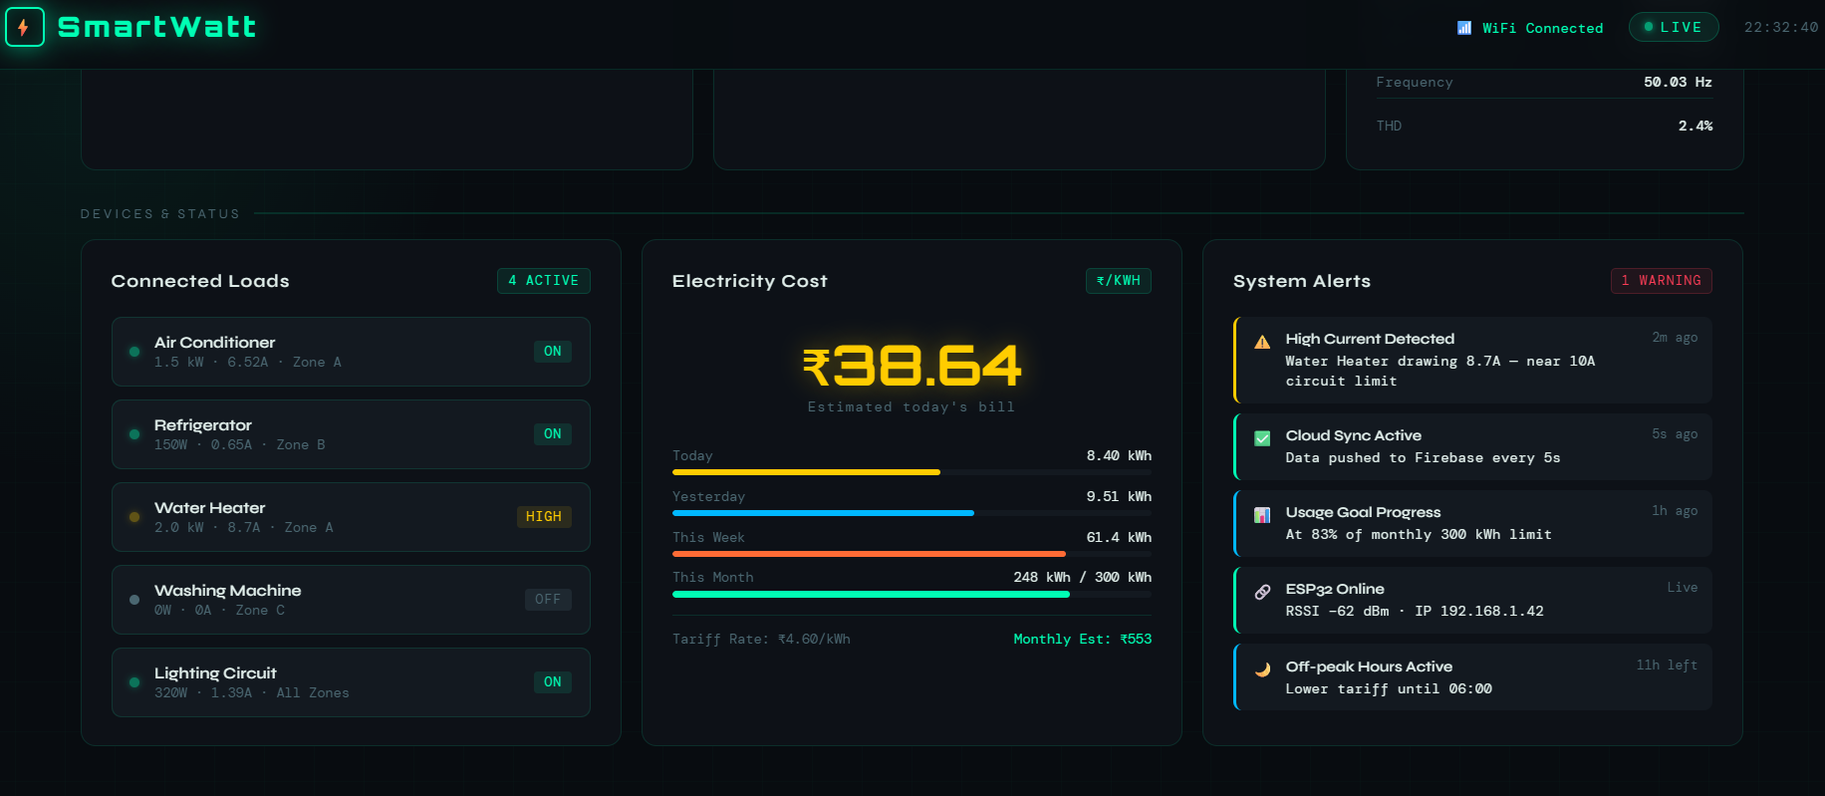

Slide 14
THANK YOU

